Slide 1
Today’s Lecture
Pointers to Object
Copy Constructor
Deep Copy vs Shallow Copy
const Class Data Members
const Class Member functions
Constructor Initializer list

Slide 2
Pointer to Objects (Header.h)
#pragma once
#include<iostream>
using namespace std;
class student
{
private:
string name;
int id;
float marks;
public:
void setdata(string N, int ID, float M)
{
name = N;
id = ID;
marks = M;
}
void getdata()
{
cout << " your name is: " << name <<"\n";
cout << " your id is: " << id << "\n";
cout << " your marks is: " << marks << "\n";
}
};

Slide 3
main.cpp
s2.setdata(nam, idd, s_marks);
s2.getdata();
s1 = &s2;
s1->getdata();
(*s1).getdata(); // another way of calling
cout << "\n";
system("pause");
}
#include<iostream>
#include<string>
#include "Header.h"
using namespace std;
int main()
{
int idd;
string nam;
float s_marks;
student* s1, s2;
s1 = new student;
cout << " Enter your name: ";
getline(cin, nam);
cout << " Enter student id: ";
cin >> idd;
cout << " Enter subject marks: ";
cin >> s_marks;

Slide 4
Multiple objects creation (Header.h)
student()
{
cin.ignore();
cout << " Enter your name: ";
getline(cin, name);
cout << " Enter student id: ";
cin >> id;
}
void display()
{
cout << " your name: " << name << " and id is: " << id << endl;
}
};
#pragma once
#include<string>
#include<string.h>
#include<iostream>
using namespace std;
class student{
private:
string name;
int id;
public:

Slide 5
Multiple objects creation (main.cpp)
#include<iostream>
#include<string>
#include"Header.h"
#include<string.h>
int main()
{
// Multiple objects
int size;
cout << " Enter how much object you want to create: ";
cin >> size;
student *obj1;
obj1 = new student[size];
student* obj1store = obj1;
for (int i = 0; i < size; i++)
{
obj1++;
}
for (int i = 0; i < size; i++)
{
obj1store->display();
obj1store++;
}
system("pause");
}

Slide 6
Multiple objects (Another Method) (main.cpp)
#include<iostream>
#include"Header.h"
using namespace std;
int main()
{
student s1(" Hassan Arshad ", 1001, " OOP ");
s1.display();
cout << "\n";
int length;
student *s_start;
cout << " how many objects you want to create: ";
cin >> length;
s_start = new student[length];
for (int i = 0; i < length; i++)
{
s_start[i].setvalue();
}
for (int i = 0; i < length; i++)
{
s_start[i].display();
cout << endl;
}
cout<<"\n";
system("pause");
}

Slide 7
Multiple objects (Another Method) (Header.h)
#pragma once
class student {
char* name;
int id;
char* subject;
public:
student();
student(const char* N, int ID, const char* SUB);
void display();
void setvalue();
};

Slide 8
Multiple objects (Another Method) (source1.cpp)
#include<iostream>
#include<string>
#include<string.h>
#include"Header.h"
using namespace std;
student::student()
{
}
student::student(const char* N, int ID, const char* SUB)
{
int size = strlen(N);
name = new char[size];
for (int i = 0; i < size; i++)
{
name[i] = N[i];
}
name[size] = '\0';
id = ID;
int size2 = strlen(SUB);
subject = new char[size2];
for (int i = 0; i < size2; i++)
{
subject[i] = SUB[i];
}
subject[size2] = '\0';
}
void student::setvalue()
{
name = new char[100];
cout << endl;
cout << " Enter your name: ";
cin>>name;
cout << " Enter your id: ";
cin >> id;
subject = new char[100];
cout << " Enter your subject name: ";
cin>>subject;
}
void student::display()
{
cout << " your name: " << name << endl;
cout << " your id: " << id << endl;
cout << " your subject: " << subject << endl;
}

Slide 9
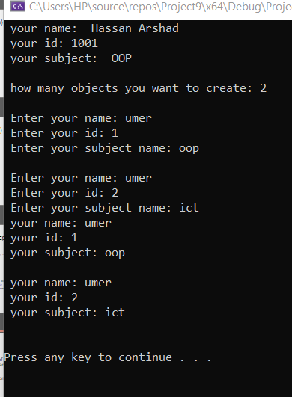
Output of the following program

Slide 10
Copy Constructor
The copy constructor is used to initialize the members of a newly created object by copying the members of an already existing object.
The copy constructor in C++ is used to copy data from one object to another.

Slide 11
Copy Constructor (Header.h)
#pragma once
#include<string>
#include<string.h>
#include<iostream>
using namespace std;
class student{
private:
string name;
int id;
public:
student() // Default Constructor
{
}
student(string N, int ID) // Parameterized Constructor
{
name = N;
id = ID;
}
void display()
{
cout << " your name is: " << name << endl;
cout << " your id is: " << id << endl;
}
};

Slide 12
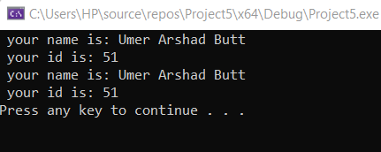
Copy Constructor (main.cpp)
#include<iostream>
#include<string>
#include"Header.h"
#include<string.h>
int main()
{
student s1("Umer Arshad Butt", 51);
s1.display();
// Copy Constructor
// Copy values from s2 to s1
student s2(s1);
s2.display();
system("pause");
}

Slide 13
Copy Constructor / Shallow copy
In shallow copy, an object is created by simply copying the data of all variables of the original object. This works well if none of the variables of the object are defined in the heap section of memory.
If some variables are dynamically allocated memory from the heap section, then the copied object variable will also reference the same memory location.
Example of shallow copy is same as simple copy constructor. Then why do we need a deep copy constructor?

Slide 14
Issue comes in the Copy constructor
An object is created by copying data of all variables, and it also allocates similar memory resources with the same value to the object.
Below is the reason why we need to go for deep copy

Slide 15
Copy constructor (Header.h)
#pragma once
#include<string>
#include<string.h>
#include<iostream>
using namespace std;
class student{
private:
string *name;
int *id;
public:
student() // Default Constructor
{
}
student(string N, int ID) // Parameterized Constructor
{
name = new string;
*name = N;
id = new int;
*id = ID;
}
string updatename()
{
*name = " Ch Ahmad Junaid ";
return *name;
}
int updateid()
{
*id = *id * 100;
return *id;
}
void display()
{
cout << " your name is: " << *name << endl;
cout << " your id is: " << *id << endl;
}
};

Slide 16
Copy constructor (main.cpp)
#include<iostream>
#include<string>
#include"Header.h"
#include<string.h>
int main()
{
student s1("Umer Arshad Butt", 51);
s1.display();
// Copy Constructor
// Copy values from s1 to s2
cout << " copy constructor s2 executed" << endl;
student s2(s1);
s2.display();
cout << "\n";
cout << " update the s1 namd and id " << endl;
// Update the s1 values
s1.updatename();
s1.updateid();
// Display the s1 value
s1.display();
cout << "\n";
cout << " It also update the s2 values whereas we do not update the s2 value" << endl;
// Display the s2 value
s2.display();
system("pause");
}

Slide 17
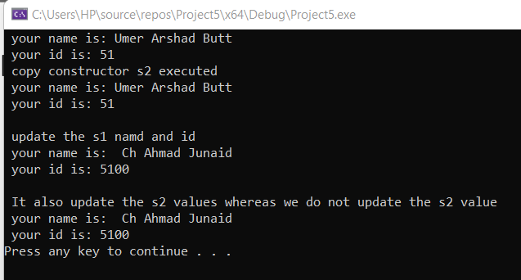
Copy constructor (output file)

Slide 18
Deep Copy (Header.h)
#pragma once
#include<string>
#include<string.h>
#include<iostream>
using namespace std;
class student{
private:
string *name;
int *id;
public:
student() // Default Constructor
{
}
student(string N, int ID) // Parameterized Constructor
{
name = new string;
*name = N;
id = new int;
*id = ID;
}
string updatename() {
*name = " Ch Ahmad Junaid ";
return *name;
}
int updateid() {
*id = *id * 100;
return *id;
}
void display() {
cout << " your name is: " << *name << endl;
cout << " your id is: " << *id << endl;
}
// Explicit Copy Constructor
student(const student& access)
{
name = new string;
*name = *(access.name);
id = new int;
*id = *(access.id);
}
};

Slide 19
Deep copy (main.cpp)
#include<iostream>
#include<string>
#include"Header.h"
#include<string.h>
int main()
{
student s1("Umer Arshad Butt", 51);
s1.display();
// Copy Constructor
// Copy values from s2 to s1
cout << " copy constructor s2 executed" << endl;
student s2(s1);
s2.display();
cout << "\n";
cout << " update the s1 namd and id " << endl;
// Update the s1 values
s1.updatename();
s1.updateid();
// Display the s1 value
s1.display();
cout << "\n";
cout << " Now its not update the s2 values" << endl;
// Display the s2 value
s2.display();
system("pause");
}

Slide 20
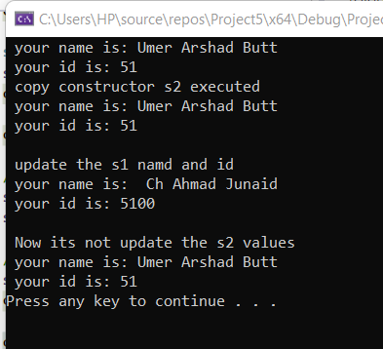
Copy constructor (output file)

Slide 21
Constant
Constant is something that does not change.
In C, and C++ we use the keyword const to make the program element constant.
const keyword may be used in many contexts in a C++ program.
const keyword can be used with:
Constant Variable
Constant function Argument
Class Data Members
Class Member functions
Object

Slide 22
Constant Variables
If you make any variable constant using const keyword, you can not change it’s value.
Constant variable must be initialized while declared.
Once initialized, if we try to change its value, then we will get compilation error. The following two cases will give us an error since in both these cases, we are trying to change the value of a const variable

Slide 23
Constant Variables
int main()
{
const int a = 5; // declaring and initializing a const variable
a = 10; // this will give compilation error
return 0;
}

Slide 24
Const Function Parameters
We can also make the type of argument and return type of a function const. Once declared constant, we will get compilation error if we try to change it.
void func( const int a ) // const argument
{
a = 5; // compilation error
}
This will result in compilation error since we cannot assign a value to any const variable after its declaration. Initialization of any const variable (in our case, a) takes place at the time of its declaration

Slide 25
Constant Class data memeber
There are data variables in class which are made const.
They are not initialized during declaration.
Their initialization occur in constructor.

Slide 26
Constant data members (Header.h)
volume(int R)
{
rad = R;
}
double formula()
{
double d;
d = 4 / 3;
d = d * pi * rad * rad * rad ;
return d;
}
};
#pragma once
#include<string>
#include<string.h>
#include<iostream>
using namespace std;
class volume{
private:
const double pi = 3.14;
int rad;
public:
volume()
{
}

Slide 27
Constant data members (main.cpp)
#include<iostream>
#include<string>
#include"Header.h"
#include<string.h>
int main()
{
volume v1(10);
double result = v1.formula();
cout << " voulme of sphere: ";
cout << result;
cout << "\n";
system("pause");
}

Slide 28
Constructor Initializer list (Header.h)
double formula()
{
double d;
d = 4 / 3;
d = d * pi * rad * rad * rad ;
return d;
}
};
#pragma once
#include<string>
#include<string.h>
#include<iostream>
using namespace std;
class volume{
private:
const double pi;
int rad;
public:
// Constructor Initialization List When you
// declared constant data outside
volume(double P, int R): pi{P}, rad{R}
{
}

Slide 29
Constructor Initializer list (main.cpp)
#include<iostream>
#include<string>
#include"Header.h"
#include<string.h>
int main()
{
volume v1(3.14, 5);
double result = v1.formula();
cout << " voulme of sphere: ";
cout << result;
cout << "\n";
system("pause");
}

Slide 30
Constant Member Function of Class
A const member function cannot change the value of any data member of the class and cannot call any member function which is not constant.
To make any member function const, we add the const keyword after the list of the parameters after the function name.
class A
{
public:
int x;
void func() const
{
x = 0; // this will give compilation error
}
};
Note that A const object can only call a const member function. This is because a const object cannot change the value of the data members and a const member function also cannot change the value of the data member of its class. So, a const object would like to call a function which does not violate its rule.
Notes:
The above code will give us compilation error because 'func()' is a const member function of class A and we are trying to assign a value to its data member 'x'.

Slide 31
Constant Member Function of Class
We cannot make constructors const
The reason for this is that const objects initialize the values of their data members through constructors and if we make the constructor const, then the constructor would not change the values of the data members and the object would remain uninitialized.

Slide 32
Constant Member Functions
Constant member functions are those functions that are denied permission to change the values of the data members of their class.
To make a member function constant, the keyword “const” is appended to the function prototype and also to the function definition header.

Slide 33
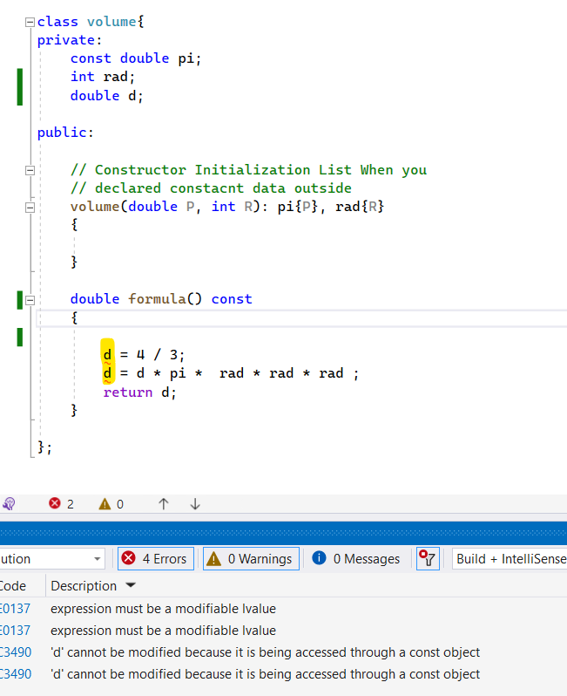
Constant Member Functions
You cannot change the value because const is mentioned in the function.
There is one way to modify it if you mention mutable keyword in class member.

Slide 34
Constant Member Function (Header.h)
double formula() const
{
d = 4 / 3;
d = d * pi * rad * rad * rad ;
return d;
}
};
#pragma once
#include<string>
#include<string.h>
#include<iostream>
using namespace std;
class volume{
private:
const double pi;
int rad;
mutable double d;
public:
// Constructor Initialization List When you
// declared constacnt data outside
volume(double P, int R): pi{P}, rad{R}
{
}

Slide 35
Constructor Initializer list (main.cpp)
#include<iostream>
#include<string>
#include"Header.h"
#include<string.h>
int main()
{
volume v1(3.14, 5);
double result = v1.formula();
cout << " voulme of sphere: ";
cout << result;
cout << "\n";
system("pause");
}

Slide 36
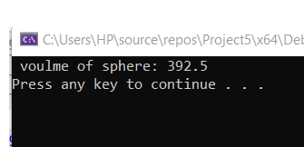
Output of the following program

Slide 37
Constant Objects of Classes
We can also make an object of class const. We make an object const by writing the const keyword at the beginning of the object declaration as shown below.
const A a(4);
We made the object a of class A const by writing the const keyword before the class name at the time of its declaration.
A const class object is initialized through the constructor.
We cannot modify the data members of a const object.

Slide 38
Constant Objects of Classes
#include <iostream>
using namespace std;
class A
{
public:
int x;
A()
{
x = 0;
}
};

Slide 39
Constant Objects of Classes
int main()
{
const A a; // declaring const object 'a' of class 'A'
a.x = 10; // compilation error
return 0;
}
Notes:
The above program will give compilation error. Since we declared 'a' as a const object of class A, we cannot change its data members. When we created 'a', its constructor got called assigning a value 0 to its data member 'x'. Since 'x' is a data member of a const object, we cannot change its value further in the program. So when we tried to change its value, we got compilation error

